Slide 1
How to Make Seven Basic Parts in SolidWorks
By Charity Fischer

Slide 2
The Basic Parts made in this PowerPoint are as follows:
Sphere
Cylinder
Cone
Box
Wedge
Pyramid
Torus

Slide 3
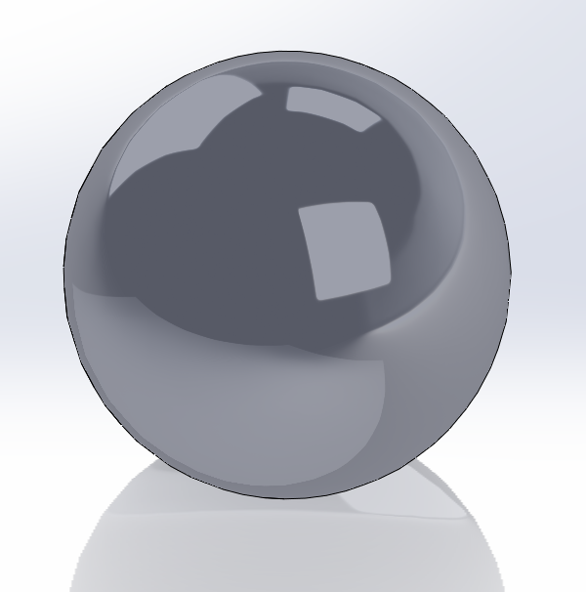
Sphere
Open SolidWorks
Set units to IPS in Document Properties tab of Settings
Create a new sketch
Draw a circle with center at the origin
Set Diameter to 1” using Smart Dimension
Draw line through center
Go to Trim Entities then select Trim to Closest
Trim sketch to leave one half circle
Select Revolved Boss/Base in Features
Choose the straight line of the half circle as the Axis of Revolution
Set direction angle to 360°
Click the checkmark, accepting the drawing

Slide 4
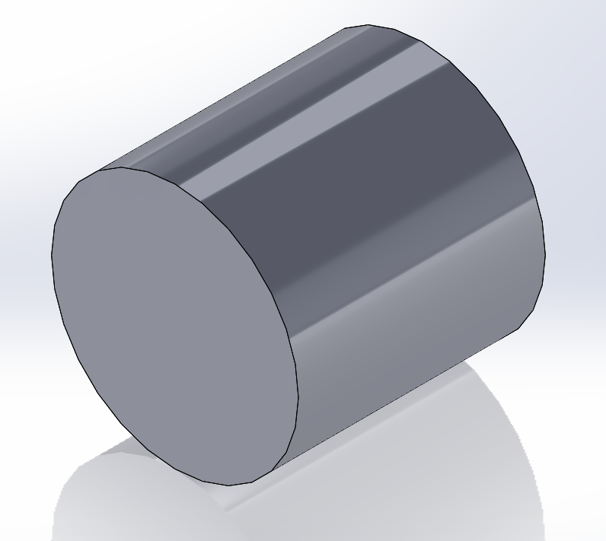
Cylinder
Open SolidWorks
Set units to IPS in Document Properties tab of Settings
Create a new sketch
Draw a circle with center at the origin
Set Diameter to 1” using Smart Dimension
Go to Extruded Boss/Base
Select the sketch
Set direction 1 to 1”
Click the checkmark, accepting the drawing

Slide 5
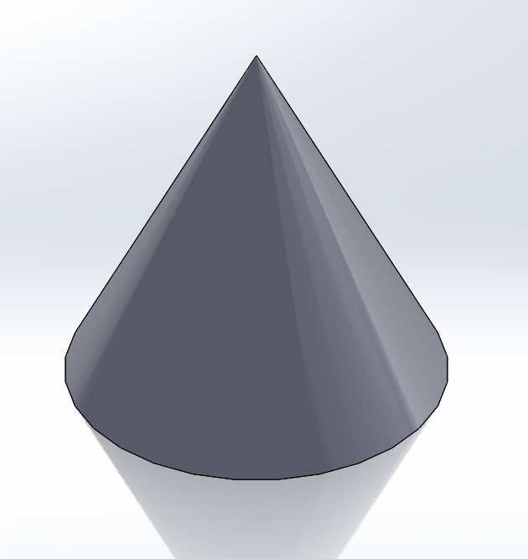
Cone
Open SolidWorks
Set units to IPS in Document Properties tab of Settings
Create a new sketch
Draw a 1” line with one end on the origin
Draw a ½” line at a right angle from the first line with one end on the origin
Draw one more line connecting both lines to make the hypotenuse
Exit sketch
Select Revolved Boss/Base in Features
Set direction angle to 360°
Click the checkmark, accepting the drawing

Slide 6
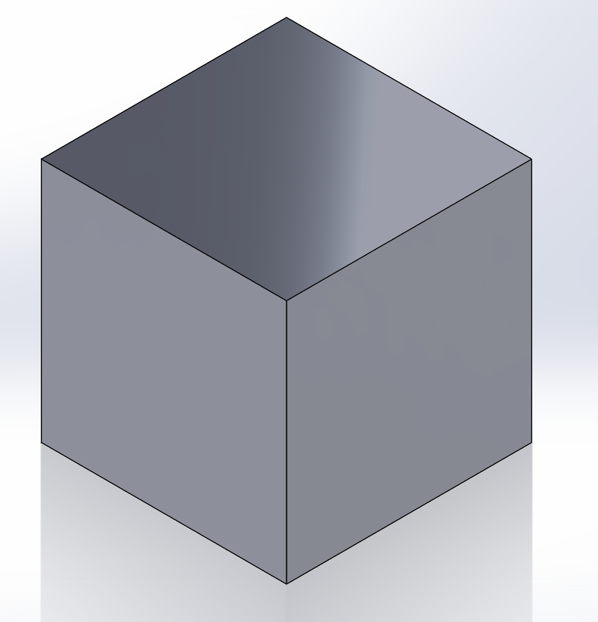
Box
Open SolidWorks
Set units to IPS in Document Properties tab of Settings
Create a new sketch
Use Center Rectangle tool to center it at origin
Use Smart dimension to set the square to 1” by 1”
Go to Extruded Boss/Base
Select the sketch
Set direction 1 to 1”
Click the checkmark, accepting the drawing

Slide 7
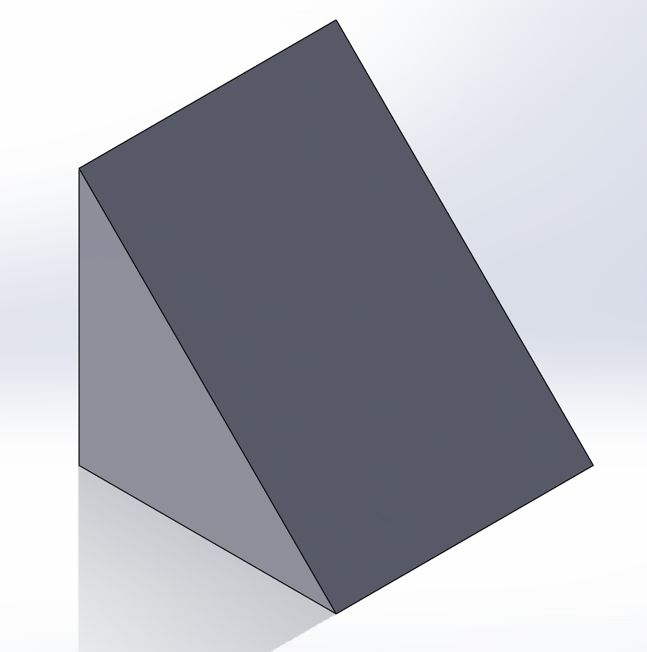
Wedge
Open SolidWorks
Set units to IPS in Document Properties tab of Settings
Create a new sketch
Draw a 1” line with one end on the origin
Draw a 1” line at a right angle from the first line with one end on the origin
Draw one more line connecting both lines to make the hypotenuse
Go to Extruded Boss/Base
Select the sketch
Set direction 1 to 1”
Click the checkmark, accepting the drawing

Slide 8
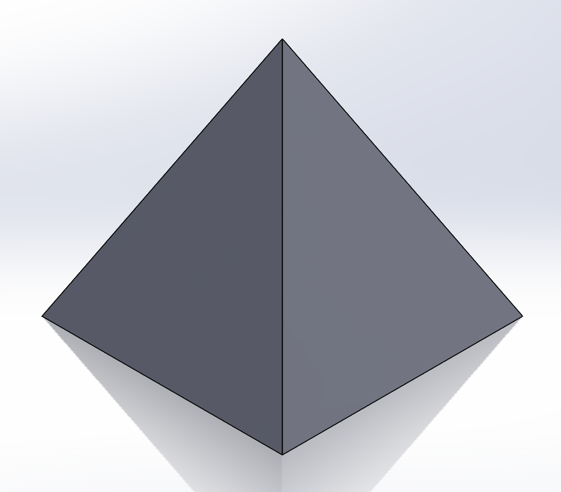
Pyramid
Open SolidWorks
Set units to IPS in Document Properties tab of Settings
Create a new sketch
Use Center Rectangle tool to center it at origin
Use Smart dimension to set the square to 1” by 1”
Go to Extruded Boss/Base
Select the sketch
Set direction 1 to 1”
Select Draft in Features
Choose the side that is to be the bottom of the pyramid as the Neutral Plane then select the sides you wish to angle as the Faces to Draft
Set Draft Angle to 26.57°
Click Reverse Direction button by the Neutral Plane
Click the checkmark, accepting the drawing

Slide 9
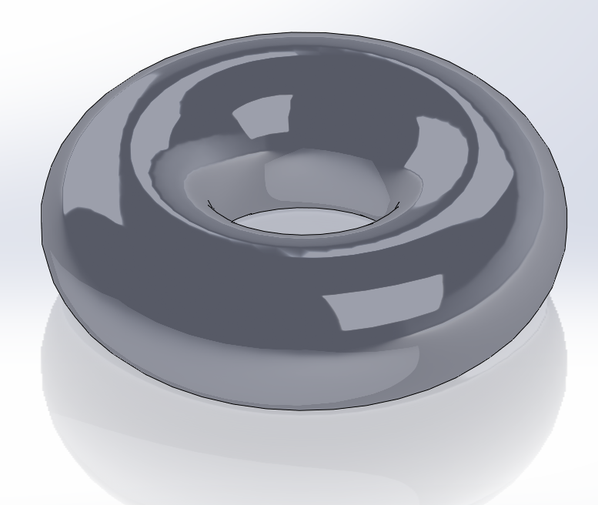
Torus
Open SolidWorks
Set units to IPS in Document Properties tab of Settings
Create a new sketch
Draw a circle whose center is 1” from the origin
Set Diameter to 1” using Smart Dimension
Draw a Centerline at the origin parallel to a vertical line of the circle
Select Revolved Boss/Base in Features
Choose the Centerline at the origin as the Axis of Revolution
Set direction angle to 360°
Click the checkmark, accepting the drawing

